Slide 1
GIS Lesson 6
Errors and Data Quality
錯誤與數據質素
2020/6/17

Slide 2
Agenda
1. Errors and Data Quality 錯誤與數據質素
A. Errors 錯誤
Definitions 定義
Examples 例子
B. Data Quality 數據質素
2. Tutorial 個別指導
Download and import two datasets with different qualities covering the same area, examining their attributes and representations in QGIS.
Accuracy vs Precision 準確度 vs 精確度
Uncertainty 不確定性
How to we measure data quality? 如何量度數據質素?
Examples 例子

Slide 3
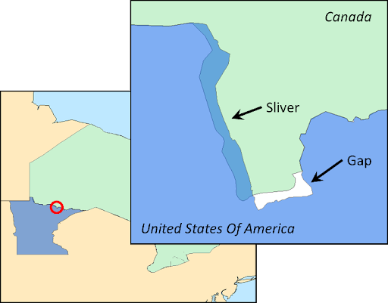
A. Errors 錯誤
Notes:
Source: https://lh3.googleusercontent.com/proxy/d06Q3smedYG9yDh_xC0Q623BSSe3JKwr9GBUiW6SkzD4c-fSkG0VnkQa0IniZMuAVtPLHjVYWdSX8aFD05IYkuVwQLh_vgWAZBJpN-aB35UHwwPvVnFTMMmpOTjV7NycLYE0SwHJJt78ny1H0JysXSwOAhQWsL9R

Slide 4

Video - Fake Neighborhoods on Google Maps (5:06)

Slide 5
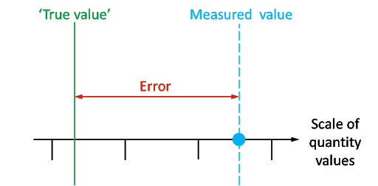
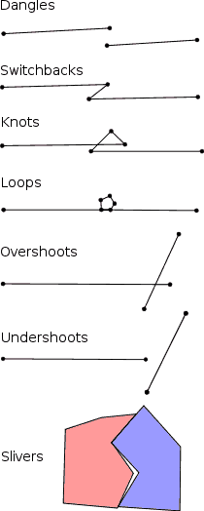
What is an error? 甚麼是錯誤?
The deviation between a measured value and a true value (所量度的數值與真正的數值之區別)
Sources of errors
Inherent (固有、已知) errors
Projections (投影法)
Data symbolization (符號化)
Construction methods (制圖方法) – Topological errors
Cartographic Abstraction (製圖抽象化) (Selection and generalization of features, emphasize some but not others)
Intentional omissions/additions (刻意忽略/添加) (the video example)
Operational (操作上) errors
Errors generated from the collection, analysis and representations of data
Examples: Random/background error, systematic errors (human bias, instrumental errors), gross errors (mistakes in data collection)
Notes:
Source: - https://lh3.googleusercontent.com/proxy/CT1Y4I316fYyCWJVzeCqnPRe5zHBsvBCynn0Rs6U9nVT9M3Zb0_uus_mpyHROUryRQ1497eZCrkQwGUId9-MSH0tOfQfzQhFwIxbuIc48DSkHMPLYW8gkmC23mM
- GP 187 L06 – Slide 6

Slide 6
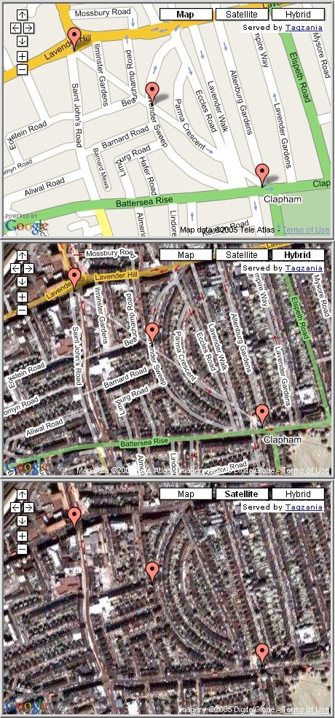
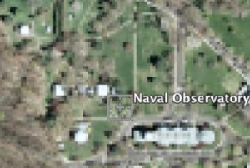
Examples of Inherent Errors
Trap Streets (陷阱街)
(Fake, prevent from copying)
Omissions (省略)
(Pixelate or remove sensitive areas of national security)
Notes:
Source: GP 187 Lecture 6 – Slides 9 and 10

Slide 7


Error Measurement – Accuracy vs Precision 量度錯誤 – 準確度 vs 精確度
Accuracy =/= Precision
Accuracy 準確度
Precision 精確度
Examples:
Positional accuracy (位置準確度)
Attribute accuracy (屬性準確度)
Examples:
Number of decimal places (小數點數目)
Resolution (解像度)
Number of categories (種類的數目)
How closely the measurements are to one another (exactness)
How closely the data match the true values (correctness)
Notes:
Source: GP 187 L06 – Slides 4 and 5

Slide 8
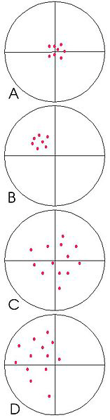
Quick Check – Which of the following has a low precision but high accuracy?
Notes:
Source: https://www.gislounge.com/gis-data-a-look-at-accuracy-precision-and-types-of-errors/#:~:text=Therefore%2C%20when%20we%20refer%20to,is%20the%20description%20of%20data.

Slide 9
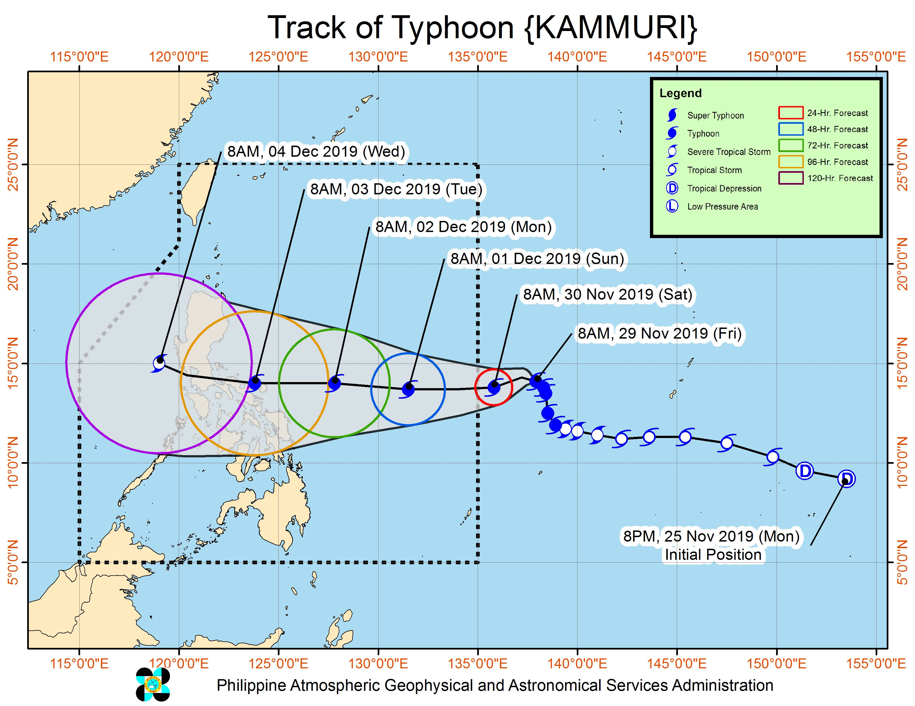
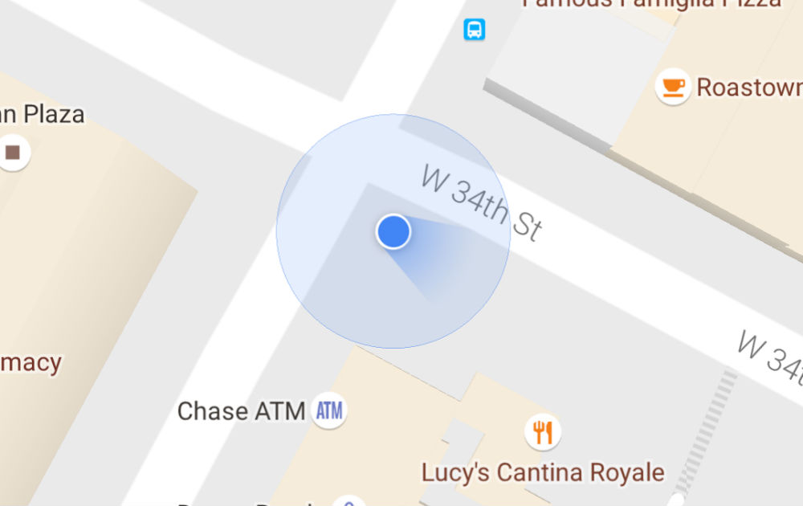
Then, what is uncertainty (不確定性)?
Typhoon Track (Cone of uncertainty)
GPS Location on Google Maps
Repeating a measurement will lead to a value within a range of the original
The range = level of uncertainty (larger range -> higher uncertainty)
Resulted from incomplete knowledge of the data
Notes:
Sources:
https://www.google.com/url?sa=i&url=https%3A%2F%2Fnews.abs-cbn.com%2Fnews%2F11%2F29%2F19%2Ftyphoon-kammuri-threatens-to-hit-during-sea-games-week-pagasa&psig=AOvVaw14LBabc75duAwE4EPNCrNp&ust=1592336198447000&source=images&cd=vfe&ved=0CAIQjRxqFwoTCODk4N7IhOoCFQAAAAAdAAAAABAI
https://www.google.com/url?sa=i&url=https%3A%2F%2Fwww.inteligentcomp.com%2F2013%2F04%2FGPS-not-working-google-map-Google-nexus-android.html&psig=AOvVaw3u2ctQZaITbPnWRYmUMTm3&ust=1592336295907000&source=images&cd=vfe&ved=0CAIQjRxqFwoTCIjj5Y7JhOoCFQAAAAAdAAAAABAD

Slide 10
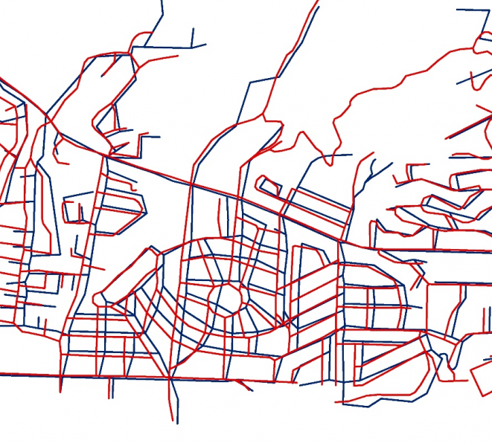
B. Data Quality 數據質素
Notes:
Source: https://www.google.com/url?sa=i&url=https%3A%2F%2Fgistbok.ucgis.org%2Ftopic-keywords%2Fspatial-data-quality&psig=AOvVaw16LBdt6dZXkctXC3680HFs&ust=1592336889668000&source=images&cd=vfe&ved=0CAIQjRxqFwoTCJDXk6nLhOoCFQAAAAAdAAAAABAD

Slide 11
How do we measure data quality? 如何量度數據質素?
Lineage (係譜)
Positional Accuracy
(位置準確度)
Attribute Accuracy
(屬性準確度)
Logical Consistency
(邏輯一致性)
Completeness
(完整性)

Slide 12
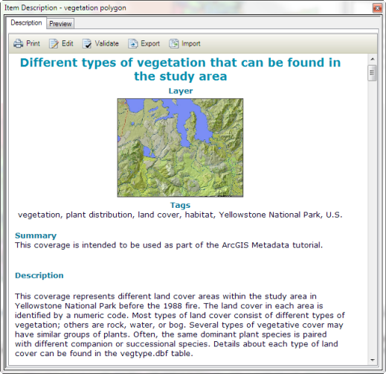
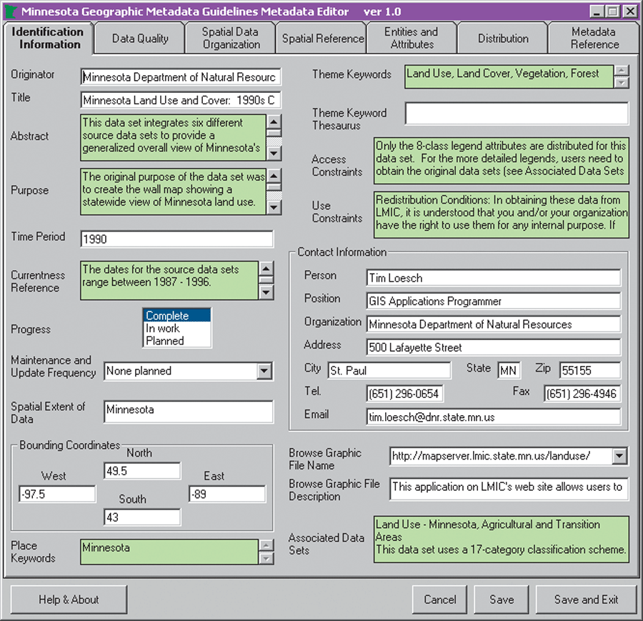
Lineage (係譜)
About the history of data (與數據的歷史有關)
Can be found in the metadata of the data (descriptions of the datasets)
Without metadata, you cannot check the sources and changes in a datasets, and thus you cannot validate the quality of the dataset.
Example information:
Who collected the data?
Who compiled the data?
Collection date
Changes in data
Contact names and emails
Notes:
Source: https://www.google.com/url?sa=i&url=https%3A%2F%2Fdesktop.arcgis.com%2Fen%2Farcmap%2F10.3%2Fmanage-data%2Fmetadata%2Fwhat-is-metadata.htm&psig=AOvVaw2GkUfvWT-OM7gn5WEIUE3b&ust=1592337615679000&source=images&cd=vfe&ved=0CAIQjRxqFwoTCPDq3ILOhOoCFQAAAAAdAAAAABAD

Slide 13
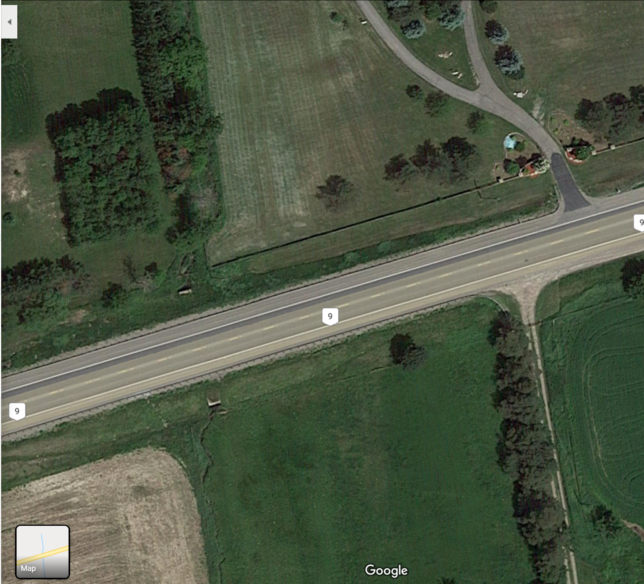
Positional Accuracy (位置準確度)
Representation of ground features on the map
Can be improved by conducting inspection on the satellite image
Example: a section of Highway 9 in Ontario has a line representation that is slightly off the actual road in the satellite image in Google Maps
Notes:
Source: GP 187 Lecture 6 – Slide 22

Slide 14
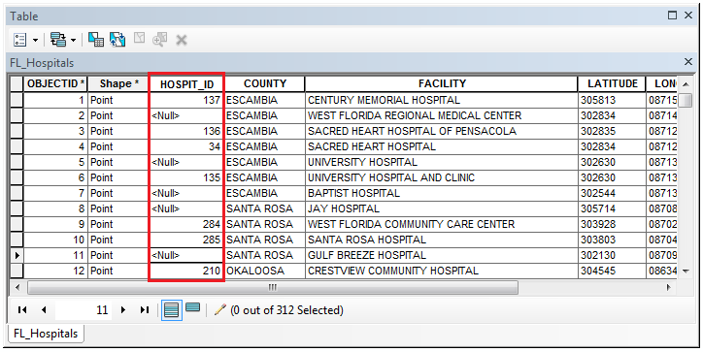
Attribute Accuracy (屬性準確度)
Is about whether a feature is described properly
Very dependent on the frequency of updates (更新頻率) of the dataset/basemap
Attribute errors can occur if there is an incorrect value or a missing value in the attribute table of a dataset
Errors can also happen when attributes are not labeled properly, e.g. a ‘road’ feature is mislabeled as a ‘vegetation’ feature
Notes:
Sources:
GP 187 Lecture 6 – Slide 23
https://saylordotorg.github.io/text_essentials-of-geographic-information-systems/s09-04-data-quality.html
https://www.google.com/url?sa=i&url=https%3A%2F%2Fsupport.esri.com%2Fen%2Ftechnical-article%2F000016100&psig=AOvVaw0hgMYsUjeX0SRjFxDQQRLs&ust=1592339854885000&source=images&cd=vfe&ved=0CAIQjRxqFwoTCNC36q3WhOoCFQAAAAAdAAAAABAI

Slide 15
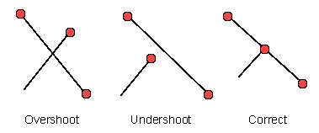
Logical Consistency (邏輯一致性)
Determine whether data are topologically correct
E.g. See if two roads (lines) connect at a node (point) or not
E.g. Incorrect example – a river flows on top of a road
Notes:
Sources
GP 187 Lecture 6 Slide 24
https://saylordotorg.github.io/text_essentials-of-geographic-information-systems/s09-04-data-quality.html

Slide 16
Completeness (完整性)
Determine if all features are included, i.e. complete.
A dataset is not complete if there are some missing values, information or topology
Examples:
Are all provinces and territories included in a Canada nationwide map?
Are all roads in York Region being represented in a York regional map?

Slide 17
Questions?

Slide 18
2. Tutorial
It’s your turn!
Now explore the two shapefiles representing municipalities.
1. Place the Municipal Boundary layer on top of the Ontario Census Division layer.
2. Zoom into the GTA and assess their qualities based on the representations of features, attribute accuracy, logical consistency and completeness.

